Slide 1
Duplicate Images Detection using Parallel Processing
18BCE0102 Jatin Kumar Dhankhar
18BCE0543 Paurush Batish

Slide 2
Index of Presentation
Abstract
Aim
Motivation
Literature survey
Existing and Proposed messages
Algorithms –
Serial Execution
Multi - Threading
Multi – Processors
Description about Dataset and Time Taken for processing
Conclusion
References

Slide 3
Abstract
Detecting duplicate images from huge number of images is a tedious task which can be automated to save time and removing duplicate data to save space.
As our usage of mobile grows, the unnecessary duplicate photo and picture files grows in device randomly, ideally every folder of the phone. The duplicate pictures/photos occupy the lots of phone memory and also reduce the operating speed of phone. Manually it is difficult to find and remove them.
We present the duplicate images detection using parallel processing from which you can scan through your entire phone and finds the duplicate image/picture/photo files for you. You can make judgement yourself if you want to delete by selecting them.
At the end we will also analyze the compute time and power consumed of processing on multiple core v/s single core using threads and provide benchmarks for both along with graphical representations.

Slide 4
Aim
Detecting Duplicate images from a large sample of given images in lesser time compared to Sequential Single Core Execution
Analysis of Processing on Multiple Core v/s Single Core using Threads

Slide 5
Motivation
Jatin had a recent trip to Pondi, He asks from his friends to upload all clicked images on google drive.
Now here comes the tedious problem, Jatin is a bit late in making his this scheme and his friends have already exchanged images among them but still scattered and few only with all.
Now he needed to get these images, and thus many duplicate images to be deleted [seems like Jatin likes to keep things clean and untidy]. And here he makes a google search: “How to Remove Duplicate Images”.
Now the google search brings in some results, where one result is about Duplicate Cleaner. But Duplicate Cleaner free plan has some limitations, limited speed in free mode, so we thought why not to make our own Duplicate Image Cleaner Pro using Parallelism Fundamentals.
That must be a long motivation story if think about it that’s the story with almost anyone who has gone on a group trip, that’s facts.
In conclusion: We end up with idea for our PDC Project

Slide 6
Literature survey
In [1] “Image quality assessment: from error visibility to structural similarity. IEEE transactions on image processing” the authors Wang, Z., Bovik, A. C., Sheikh, H. R., & Simoncelli, E. P. develop a method for assessing perceptual image quality traditionally attempted to quantify the visibility of errors (differences) between a distorted image and a reference image using a variety of known properties of the human visual system. Under the assumption that human visual perception is highly adapted for extracting structural information from a scene, we introduce an alternative complementary framework for quality assessment based on the degradation of structural information. As a specific example of this concept, we develop a Structural Similarity Index and demonstrate its promise through a set of intuitive examples, as well as comparison to both subjective ratings and state-of the-art objective methods on a database of images compressed with JPEG and JPEG2000

Slide 7
Continued → 2
In [3] “Fast image inpainting using similarity of subspace method” the authors Hosoi, T., Kobayashi, K., Ito, K., & Aoki, T. propose a model for Image inpainting is a technique for estimating missing pixel values in an image by using the pixel value information obtained from neighbour pixels of a missing pixel or the prior knowledge derived from learning the object class. In this paper, we propose a fast and accurate image inpainting method using similarity of the subspace. The proposed method generates the subspace from many images related to the object class in the learning step and estimates the missing pixel values of the input image belonging to the same object class so as to maximize the similarity between the input image and the subspace in the inpainting step. Through a set of experiments, we demonstrate that the proposed method exhibits excellent performance in terms of both inpainting accuracy and computation time compared with conventional algorithms.

Slide 8
Continued → 3
In [4] “Image similarity using Fourier transform” the authors Narayanan, S., & Thirivikraman, P. K. use a similarity measure for images based on values from their respective Fourier Transforms is proposed for image registration. The approach uses image content to generate signatures and is not based on image annotation and therefore does not require human assistance. It uses both, the real and complex components of the FFT to compute the final rank for measuring similarity. Any robust approach must accurately represent all objects in an image and depending on the size of the image data set, diverse techniques may need to be followed. This paper discusses implementation of a similarity rating scheme through the Open CV library and introduces a metric for comparison, carried out by considering Intersection bounds of a covariance matrix of two compared images with normalized values of the Magnitude and Phase spectrum. Sample results on a test collection are given along with data using existing methods of image histogram comparison. Results have shown that this method is particularly advantageous in images with varying degrees of lighting.

Slide 9
Continued → 4
In [6] “Image Edge Detection Based On Opencv” the authors Xie, G., & Lu, W. introduce a method of image edge detection to determine the exact number of the copper core in the tiny wire based on OpenCV with rich computer vision and image processing algorithms and functions. Firstly, we use high-resolution camera to take picture of the internal structure of the wire. Secondly, we use OpenCV image processing functions to implement image pre-processing. Thirdly we use morphological opening and closing operations to segment image because of their blur image edges. Finally the exact number of copper core can be clearly distinguished through contour tracking. By using of Borland C++ Builder 6.0, experimental results show that OpenCV based image edge detection methods are simple, high code integration, and high image edge positioning accuracy.

Slide 10
Continued → 5
In [7] “Parallel astronomical data processing with Python: Recipes for multicore machines” the authors Singh, N., Browne, L. M., & Butler, R. propose parallel processing recipes for multicore machines for astronomical data processing. The target audience is astronomers who use Python as their preferred scripting language and who may be using PyRAF/IRAF for data processing. Three problems of varied complexity were benchmarked on three different types of multicore processors to demonstrate the benefits, in terms of execution time, of parallelizing data processing tasks. The native multiprocessing module available in Python makes it a relatively trivial task to implement the parallel code. We have also compared the three multiprocessing approaches—Pool/Map, Process/Queue and Parallel Python . Our test codes are freely available and can be downloaded from our website.

Slide 11
Continued → 6
In [9] “Composable multi-threading for Python libraries.” the author Malakhov, A. tells that python is popular among numeric communities that value it for easy to use number crunching modules like [NumPy], [SciPy], [Dask], [Numba], and many others. These modules often use multi-threading for efficient multi-core parallelism in order to utilize all the available CPU cores. Nevertheless, their threads can interfere with each other leading to overhead and inefficiency if used together in one application. The loss of performance can be prevented if all the multi-threaded parties are coordinated. This paper describes usage of Intel® Threading Building Blocks (Intel® TBB), an open-source cross-platform library for multi-core parallelism [TBB], as the composability layer for Python modules. It helps to unlock additional performance for numeric applications on multi-core systems.

Slide 12
Continued → 7
In [10] “PX4: A node-based multithreaded open source robotics framework for deeply embedded platforms” the authors Meier, L., Honegger, D., & Pollefeys, M. present a novel, deeply embedded robotics middleware and programming environment. It uses a multithreaded, publish-subscribe design pattern and provides a Unix-like software interface for micro controller applications. We improve over the state of the art in deeply embedded open source systems by providing a modular and standards-oriented platform. Our system architecture is centered around a publish-subscribe object request broker on top of a POSIX application programming interface. This allows to reuse common Unix knowledge and experience, including a bash-like shell. We demonstrate with a vertical take off and landing (VTOL) use case that the system modularity is well suited for novel and experimental vehicle platforms. We also show how the system architecture allows a direct interface to ROS and to run individual processes either as native ROS nodes on Linux or nodes on the micro controller, maximizing interoperability. Our microcontroller-based execution environment has substantially lower latency and better hardware connectivity than a typical Robotics Linux system and is therefore well suited for fast, high rate control tasks.

Slide 13
Existing and Proposed Solutions
Existing Solutions →
Duplicate Photos Fixer Pro
Duplicate Photo Finder
Anti-Twin
VisiPics
Similar Image Search
Awesome Duplicate Photo Finder
Proposed Solution →
An open source Python package to remove duplicate Images
Modules used –
import cv2
import NumPy as np
import glob
import time
import multiprocessing
import threading
import sys

Slide 14
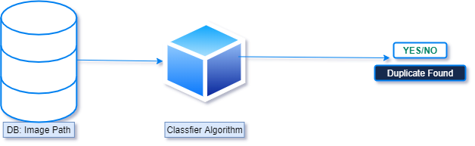
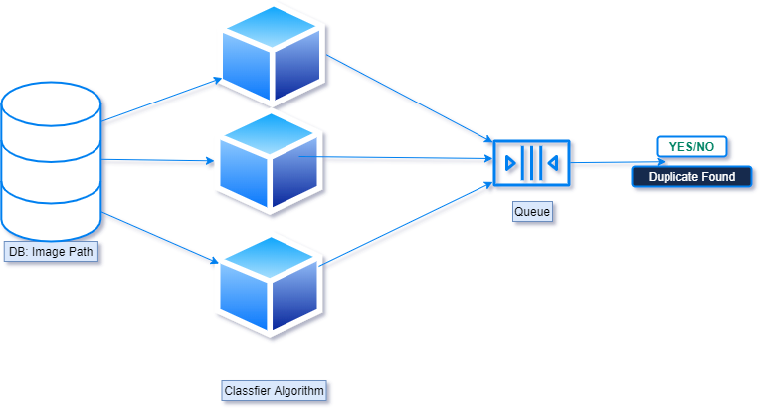
Algorithms
Serial Algorithm
Parallel Algorithm

Slide 15
Basic Algorithm
def find_duplicates(image_):
duplicates = ''
try:
image_to_compare = cv2.imread(image_)
if original.shape == image_to_compare.shape:
difference = cv2.subtract(original, image_to_compare)
b, g, r = cv2.split(difference)
if cv2.countNonZero(b) == 0 and cv2.countNonZero(g) == 0 and cv2.countNonZero(r) == 0:
duplicates = image_
return duplicates
except Exception as e:
pass

Slide 16
Explanation of the Algorithm
We have created a working Script to detect duplicate images which identifies duplicate images recursively using multiprocessing library of python
In order to compute the difference between two images we’ll be utilizing the Structural Similarity Index, first introduced by Wang et al. in their 2004 paper, Image Quality Assessment: From Error Visibility to Structural Similarity.
This method is already implemented in the scikit-image library for image processing.
The trick is to learn how we can determine exactly where, in terms of (x, y)- coordinate location, the image differences are.
To accomplish this, we’ll first need to make sure our system has Python, OpenCV, scikit-image, and imutils.

Slide 17
Serial Algorithm Vs Parallel Algorithm
Search for Images Recursively from a given starting directory
Sequential –
Compare two images by their RGB values and find image similarity using cv2 library sequentially
Multiple-Processors
Compare two images by their RGB values and find image similarity using cv2 library by spawning processes using multiprocessing library API
Threading –
Compare two images by their RGB values and find image similarity using cv2 library by passing each comparison to a new thread

Slide 18
Multiprocessing vs Multithreading
Multiprocessing adds CPUs to increase computing power.
Multiple processes are executed concurrently.
Creation of a process is time-consuming and resource intensive.
Multiprocessing can be symmetric or asymmetric.
The multiprocessing library in Python uses separate memory space, multiple CPU cores, bypasses GIL limitations in CPython, child processes are killable (ex. function calls in program) and is much easier to use.
Some caveats of the module are a larger memory footprint and IPC’s a little more complicated with more overhead.
Multithreading creates multiple threads of a single process to increase computing power.
Multiple threads of a single process are executed concurrently.
Creation of a thread is economical in both sense time and resource.
The multithreading library is lightweight, shares memory, responsible for responsive UI and is used well for I/O bound applications.
The module isn’t killable and is subject to the GIL.
Multiple threads live in the same process in the same space, each thread will do a specific task, have its own code, own stack memory, instruction pointer, and share heap memory.
If a thread has a memory leak it can damage the other threads and parent process.

Slide 19
Important Details
For Smaller Sample Thread works better but on creation of too many threads then comes context switch in play which acts as a barrier
But Creating a Thread is a cheap process when creating limited number of threads as they all are sharing same resources and hence quite faster than Multiple Processing at that time.
Multiple Processors have there own resource bucket, they are GIL safe and can work parallely because of this reason with increase in data they worked better than threading

Slide 20
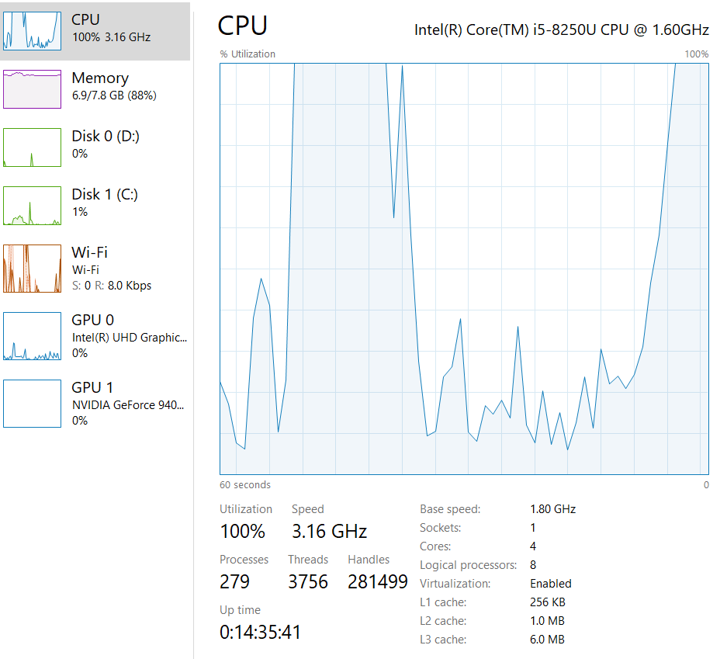
How is CPU influenced
We found that
CPU Utilization becomes 88% for both Multiprocessing and Multithreading(depends upon the Hardware sometimes a 100%)
CPU utilization remains lower and around 26% which is normal for Single Processing and Single Threaded application

Slide 21
Conclusion
Use of Threading is enough and more suited in Applications like GUI and Networking as it’s less resource intensive, Both Multiprocessing and Multithreading have similar performance in I/O bound operations.
Since most online servers provide with single core only so threaded apps are more used but for Research purposes we have need more computation power and parallel execution with less complication and there comes Multiple Processors in to rescue.

Slide 22
References
https://docs.python.org/3/library/multiprocessing.html
https://docs.python.org/3/library/threading.html
https://opencv.org/
[1] Wang, Z., Bovik, A. C., Sheikh, H. R., & Simoncelli, E. P. (2004). Image quality assessment: from error visibility to structural similarity. IEEE transactions on image processing, 13(4), 600-612.
[2] Narayanan, S., & Thirivikraman, P. K. (2015). Image similarity using fourier transform. Journal Impact Factor, 6(2), 29-37.
[3] Xie, G., & Lu, W. (2013). Image Edge Detection Based On Opencv. International Journal of Electronics and Electrical Engineering, 1(2), 104-6.
[4] Singh, N., Browne, L. M., & Butler, R. (2013). Parallel astronomical data processing with Python: Recipes for multicore machines. Astronomy and Computing, 2, 1-10.
[5] Malakhov, A. (2016, July). Composable multi-threading for Python libraries. In Proceedings of the Python in Science Conferences.
[6] Meier, L., Honegger, D., & Pollefeys, M. (2015, May). PX4: A node-based multithreaded open source robotics framework for deeply embedded platforms. In 2015 IEEE international conference on robotics and automation (ICRA) (pp. 6235-6240). IEEE.

